Slide 1

.NET Core: Developing Cross-Platform Web Apps with ASP.NET Core – WorkshopPLUS
< Engineer Name >
Premier Field Engineer
v3.1

Slide 2
For more information, see Use of Microsoft Copyrighted Content at
http://www.microsoft.com/en-us/legal/intellectualproperty/Permissions/default.aspx
Internet Explorer, Microsoft, Visual Studio, and Windows are either registered trademarks or trademarks of Microsoft Corporation in the United States and/or other countries. Other Microsoft products mentioned herein may be either registered trademarks or trademarks of Microsoft Corporation in the United States and/or other countries. All other trademarks are property of their respective owners.

Slide 3
How to View This Presentation
To switch to Notes Page view:
On the ribbon, click the View tab, and then click Notes Page
To navigate through notes, use the Page Up and Page Down keys
Zoom in or zoom out, if required
In the Notes Page view, you can:
Read any supporting text
Terminology List—a list of terms used in this course is provided in the Notes section.
Add notes to your copy of the presentation, if required
Take the presentation files home with you
Notes:
Terminology List:

Slide 4
Module 8: Routing
Module Overview
Notes:
This module includes the following sections:
Section 1: Routing and URL Overview
Section 2: Routing Fundamentals
Section 3: ASP.NET MVC Routing Techniques
After completing this module, you will be able to:
Understand Routing and the URL structure.
Create, edit and debug routes.
Use ASP.NET MVC Routing techniques and strategies.

Slide 5
Module 8: Routing
Section 1: Routing and URL Overview
Lesson: Routing and URL Overview

Slide 6
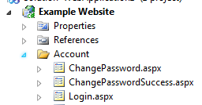
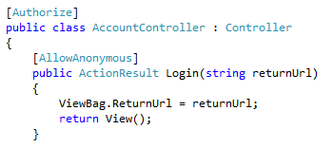

URL
URL can represent physical files on disk in ASP, JSP, PHP, ASP.NET (without routing), etc.
ASP.NET Model-View-Controller (MVC) maps URL to action methods of Controller classes. And Razor Pages maps to actions methods.
http://example.com/ Account/Login.aspx
http://example.com/ Account/Login
Notes:
In Classic ASP, JSP, PHP, and ASP.NET (without routing), the URL represents a physical file on disk. In the above example, you see that http://example.com/Account/Logic.aspx is pointing to the Login.aspx file under Account folder of the website project. There is a direct relationship between the URL and the physical file on disk. A request for the URL is received by the web server, which executes the file code to produce a response.
On the other hand, in ASP.NET MVC a URL points to ‘action’ methods of controller classes rather than physical files. Action methods serve up the response. In the example above, Account segment of the URL is mapped to the AccountController class, and Login is mapped to the Login action method in AccountController class. Login method returns a view that is eventually shown in the user’s browser.

Slide 7
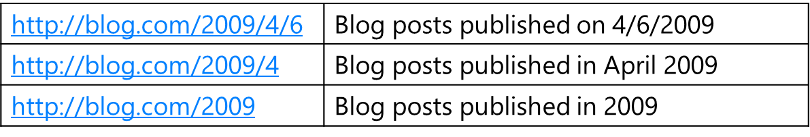
URL Guidelines
A domain name easy to remember and easy to spell
Short URLs
Easy-to-type URLs
URLs that reflect the site structure
Hackable URLs
Persistent URLs:
URLs that do not change over time
Avoid URL breakage from caller sites
Notes:
There are some URL design guidelines for improved usability:
A domain name easy to remember and easy to spell
Short URLs
Easy-to-type URLs
URLs that reflect the site structure.
Hackable URLs: In the example above, http://blog.com/2009/4/6 will return blog posts published on 4/6/2009. In order to look for all blog posts in April 2009, the user should neither use the blog search or click on the month link. If the URL was hackable, the user can just remove the day from the URL, and the blog will return all posts from April 2009. In the same way, the user can just tweak the URL to search for all blog posts published in the year 2009.
Persistent URLs:
URLs that do not change over time.
Avoid URL breakage from caller sites: If the URLs are not persistent, the links from referring/calling sites break as soon as URLs change. To avoid breaking the incoming traffic, URLs should be planned carefully before launching a website. URLs should remain persistent as much as possible after a website launch.

Slide 8
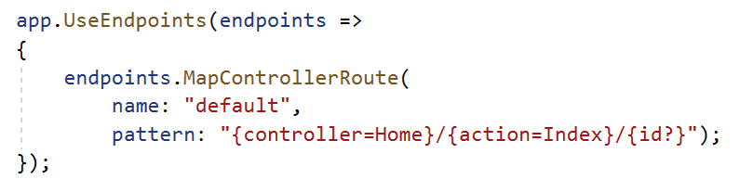
ASP.NET MVC Routing
A route is a URL pattern mapped to a handler
Handler can be a physical file or action method in a controller
Route instance specifies:
URL pattern
Route handler
Route name (optional)
ASP.NET MVC Routing also constructs outgoing URLs corresponding to controller actions
Notes:
A route is a URL pattern that is mapped to a handler. The handler can be a physical file, such as an .aspx file in a Web Forms application. A handler can also be a class that processes the request, such as a controller in an MVC application. To define a single route (https://docs.microsoft.com/en-us/aspnet/core/mvc/controllers/routing?view=aspnetcore-3.1), use MapControllerRoute inside the UseEndpoints routing middleware and specify the URL Pattern and optionally a name for the route. Most apps with controllers and views use a route template similar to the default route.
The route template “{controller=Home}/{action=Index}/{Id?}” matches a URL path like /Products/Details/5. Extracts the route values {controller = Products, action = Details, id = 5} by tokenizing the path. The extraction values results in a match if the app has a controller named ProductsController and Details action.
For more information, see: https://docs.microsoft.com/en-us/aspnet/core/fundamentals/routing?view=aspnetcore-3.1

Slide 9
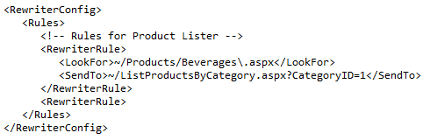
Routing vs. URL Rewriting
Routing | URL Rewriting
Used for mapping a URL to a resource | Often used to map old URLs to a new set of URLs
Routing embodies resource-centric view; never rewrites URL | Rewrites URLs to correctly map to the resource
Routing helps generate URLs using the same routing rules | URL rewriting only applies to incoming requests
Performed at ASP.NET level | Besides ASP.NET, it can be implemented with Internet Server API (ISAPI) filters at Internet Information Services (IIS) level
app.UseEndpoints(endpoints => { endpoints.MapControllerRoute( name: "default", pattern: "{controller=Home}/{action=Index}/{id?}"); });
Notes:
Both techniques are used to create URLs that are:
Short
Easy to type
Visualize the site structure
Hackable: Allowing the user to navigate through the site by hacking off parts of the URL
However, there are differences between them which are highlighted above.
The main difference is that routing is used for mapping a URL to a resource as specified by a routing rule. On the other hand, URL rewriting is often used to map old URLs to a new set of URLs.
Another key difference is that routing is used to generate URL using the same mapping rules, whereas URL rewriting is applied to incoming requests and never creates a URL.
URL Rewriting Implementation
URL rewriting can be implemented with ISAPI filters at the IIS Web server level, or with either HTTP modules or HTTP handlers at the ASP.NET level
This article focuses on implementing URL rewriting with ASP.NET, so we will not be delving into the specifics of implementing URL rewriting with ISAPI filters
There are, however, numerous third-party ISAPI filters available for URL rewriting, such as:
ISAPI Rewrite (http://www.isapirewrite.com/)
PageXChanger (http://port80software.com/products/pagexchanger/)

Slide 10
Module 8: Routing
Section 2: Routing Fundamentals
Lesson: Routing Fundamentals

Slide 11
Request Routing
ASP.NET 4
ASP.NET Core
ASP.NET MVC Request
ASP.NET Web API Request
ASP.NET MVC Request
ASP.NET Web API Request
ASP.NET MVC Routing Implementation
ASP.NET Web API Routing Implementation
ASP.NET MVC Routing Implementation
Similar behavior
Separate implementations
Developed by two different teams in Microsoft
Same implementation and behavior
Share the same framework
Rewritten from ground-up

Slide 12
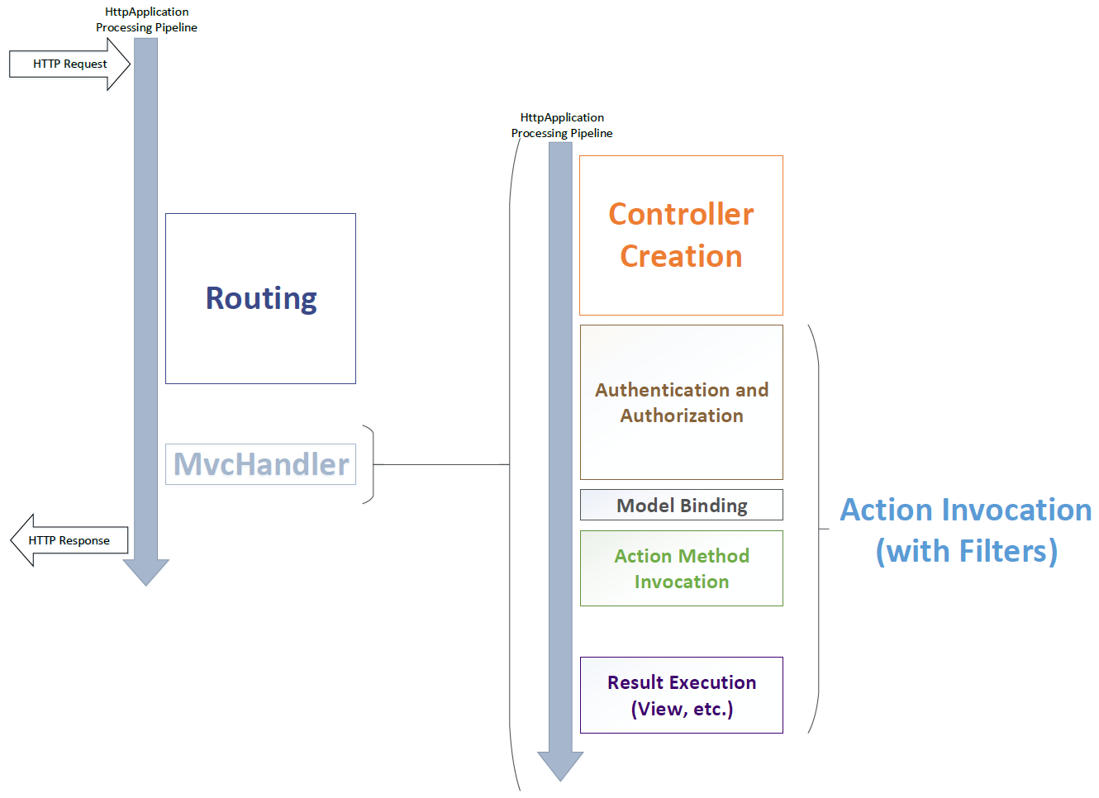
ASP.NET Core MVC: Routing in HTTP Application Processing Pipeline
ASP.NET Core MVC implements routing through middleware.

Slide 13
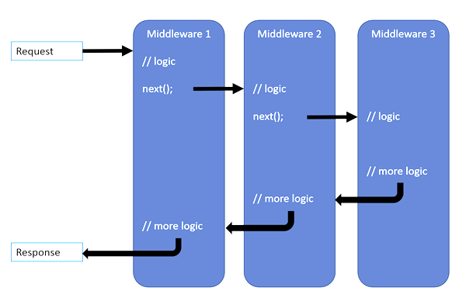
ASP.NET Core MVC Routing Pipeline [Middleware]
Routing middleware tries to match the request with routes in route collection.
If one of the routes matches the request, it looks for the handler for the route.
The RouteAsync method of the handler is called. A flag called IsHandled is set to true to mark successful handling of request.
If IsHandled is set to false, it means the route was not able to handle the request, and that the next route should be tried.
Routing
Middleware
Notes:
ASP.NET Core MVC uses middleware for adding MVC and routing to application pipeline.
When a request is processed by ASP.NET Core, the routing middleware will try to match the request with routes in the route collection.
If one of the routes matches the request, it looks for the handler for the route.
The RouteAsync method of the handler is called.
The RoutingContext has a flag called IsHandled. If that is set to true, it means the request was successfully handled by the handler. If it is set to false, it means the route was not able to handle the request, and that the next route should be tried.

Slide 14
URL Parameter Value Mapping
URL Pattern: {first}/{second}/{third}
URL | URL Parameter Values
~/Products/Show/123 | first = “Products”; second = “Show” third = “123”
~/electronics/pcs/baz | first = “electronics”; second = “pcs” third = “baz”
~/a.b/b-c | first = “a.b”; second = “b-c” third = “”
Segment Segment Segment
URL: ~/site/{controller}.{action}/{id}
Literal Parameter Parameter Parameter
Notes:
A URL consists of several segments. A segment is everything in between slashes but not including the slashes.
Each segment either consists of literals or parameters or the combination of the two. Parameters are delimited using curly brackets.

Slide 15
URL Patterns
Route Definition | Example of Matching URL
{controller}/{action}/{id} | ~/Products/show/beverages
{table}/Details.aspx | ~/Products/Details.aspx
blog/{action}/{entry} | ~/blog/show/123
{reporttype}/{year}/{month}/{day} | ~/sales/2008/1/5
{locale}/{action} | ~/US/show
{language}-{country}/{action} | ~/en-US/show
{controller}.{action}.{id} | ~/Products.Show.123
Notes:
The above table shows a list of URL patterns and examples of URLs that match with respective patterns.
We cannot have two parameters adjacent to each other without a liberal to separate them in between.

Slide 16
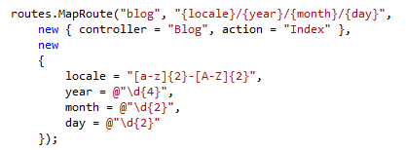
Route Constraints
Constraints allow you to apply a regular expression to URL segments to restrict request matching
Example URL | Match/No-Match?
~/en-US/08 | No match
~/en-US/08/05/25 | No match
~/en-GB/2008/05/25 | Match
~/fr-FR/2012/04/2 | No match
~/fr-FR/2012/04/02 | Match
Notes:
Constraints allow you to apply a regular expression to a URL segment to restrict whether or not the route will match the request. If any of the constraints do not match, the route is not a match for the request, and the routing moves onto the next route.
\d{4} means any string containing four consecutive digits such as, “abcd1235ff”. However, routing automatically wraps the specific constraint expression with ^ and $ characters to ensure that the value exactly matches the expression. Hence, the actual regular expression is “^\d{4}$”. Therefore, only “1235” is a match while “abcd1235ff” is not.

Slide 17
Multiple URL Parameters in a Segment
Route URL may have multiple parameters in a segment
Parameters cannot be adjacent to avoid ambiguity
Route URL | Request URL | Route Data Result
{filename}.{ext} | ~/Foo.xml.aspx | filename=“Foo.xml” ext=“aspx”
My{title}-{cat} | ~/MyHouse-dwelling | title=“House” cat=“dwelling”
{foo}abc{bar} | ~/xyzxyzabcblah | foo=“xyzxyz” bar=“blah”
{title}{artist} | - | -
{Filename}{ext} | - | -

Slide 18
Demo: URL Patterns
Notes:
Demo Script:
Open project Demos\Module 08 - Routing\RoutingSample.Web
Start the app and enumerate all routes and explain how each route is called and why.
List of routes:
/api/store
/hello/world
/api/status/HelloMicrosoft
/store/UK/MySuperAction
/store/US/MySuperAction
/localized/en-US and /localized/ru-RU
Configuration is described in Startup.cs Configure method.

Slide 19
Module 8: Routing
Section 3: ASP.NET MVC Routing Techniques
Lesson: Routing and MVC

Slide 20
Route Configuration
Startup.cs:
public void ConfigureServices(IServiceCollection services)
{
//Add MVC Controllers and Views
services.AddControllersWithViews();
}
public void Configure(IApplicationBuilder app, IWebHostEnvironment env)
{
app.UseRouting();
app.UseEndpoints(endpoints =>
{
endpoints.MapControllerRoute(
name: "default",
pattern: "{controller=Home}/{action=Index}/{id?}");
});
}

Slide 21
Route Mapping to Controller Actions
URL Pattern: {controller}/{action}/{id}
URL: ~/albums/display/123
public class AlbumsController : Controller
{
public ActionResult Display(int id)
{
// Do something
return View();
}
}
Notes:
ASP.NET MVC contains some special parameter names to function correctly. These parameter names are {controller} and {action}.
The value of the {controller} parameter is used to instantiate a controller class to handle the request. MVC appends the suffix Controller to the value of the {controller} URL parameter and attempts to locate a type of that name case insensitively.
The value of the {action} parameter is mapped to controller action directly.
The rest of the URL parameters are mapped to parameters passed to action method.

Slide 22
Optional and Default Parameters
Route URL Pattern | Examples of Matching URLs
{controller=Home}/{action=Index}/{id?} | /albums/display/123 /albums/display /albums /
Default Parameters
Controller = Home
Action = Index
Optional Parameter
Id
Notes:
Default values are used when the URL does not provide value for the respective parameters.
A URL will match a URL pattern defined in the rule when an optional URL parameter is not provided, as shown in the examples above.

Slide 23
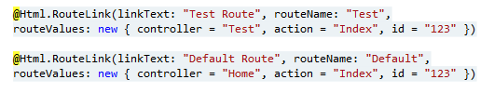
Named Routes
Always use route names to avoid ambiguities during route generation
Performance improvement for routing engine
Notes:
What happens if we do not use named routes:
Let us add an innocent route mapper at the top of RegisterRoute method to map to a static page:
routes.MapRoute("new", "static/url", "~/aspx/somepage.aspx");
For incoming requests, the route will only match those requests that exactly match “/static/url” but will not match other requests. However, when we generate URLs, all the route generation requests will be handled by this route.
For example,
@Html.RouteLink(linkText: "Test Route", routeName: "Test", routeValues: new { controller = "Test", action = "Index", id = "123" })
The above RouteLink call will generate the following URL:
/static/url?controller=Test&action=Index&id=123
Using named routes, we can specifically request the routing engine to use a particular route definition for route generation.
Moreover, since the routing engine no longer has to match the URL patterns, it also leads to better performance for route generation.

Slide 24
Demo: Constraint in MVC
Notes:
Demo Script:
Open project Demos\Module 08 - Routing\RoutingConstraintDemo
Open Startup.cs and show how we will configure route constraints
services.AddRouting(options =>{options.ConstraintMap.Add("locale", typeof(LocaleConstraint));});
Set a breakpoint in LocaleConstraint in method Match
Start an app and show that URL that will match Constraint will be generated and successfully working. But for URL that not passed it, even link will not be generated.

Slide 25
Module 8: Routing
Section 3: ASP.NET MVC Routing Techniques
Lesson: Areas

Slide 26
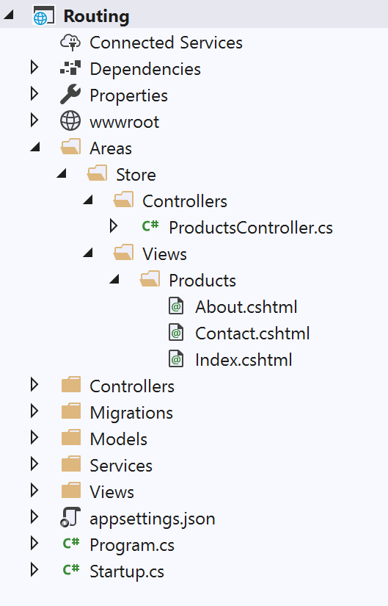
Areas
MVC areas separate a large MVC application into smaller functional groups
For example, a large e-commerce site is divided into areas for storefront, product reviews, user accounts, etc.
Area guidelines:
Areas directory must exist as project child directory
Areas contains subdirectory for each area
Controllers should be located at: /Areas/[area]/Controllers/[controller].cs
Views should be located at: /Areas/[area]/Views/[controller]/[action].cshtml
Notes:
Some applications can have a large number of controllers, and each controller can be associated with several views. For these types of applications, the default ASP.NET MVC project structure can become unwieldy.
To accommodate large projects, ASP.NET MVC lets you partition Web applications into smaller units that are referred to as areas. Areas provide a way to separate a large MVC Web application into smaller functional groups. An area is effectively an MVC structure inside an application. An application could contain several MVC structures (areas).
For example, a single large e-commerce application might be divided into areas that represent the storefront, product reviews, user account administration, and the purchasing system. Each area represents a separate function of the overall application.

Slide 27
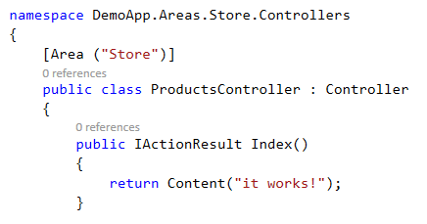
Area Registration and Linking
Area Registration
Area Linking in Views
app.UseEndpoints(endpoints =>
{
//For any Area
endpoints.MapControllerRoute(
name: "AreaRoute",
pattern: "{area:exists}/{controller=Home}/{action=Index}/{id?}");
//For specific Store Area
//endpoints.MapAreaControllerRoute(name: "areaStore", areaName: "Store", pattern: "{area:exists}/{controller=Home}/{action=Index}");
endpoints.MapControllerRoute(
name: "default",
pattern: "{controller=Home}/{action=Index}/{id?}");
});
Startup.cs
~/Areas/Store/Controllers/ProductController.cshtml

Slide 28
Areas
[Area("Admin")]
public class MenuController : Controller
{
// eg: /admin/menu/login
public ActionResult Login() { ... }
// eg: /admin/menu/show-options
[Route("show-options")]
public ActionResult Options() { ... }
// eg: /stats
[Route("~/stats")]
public ActionResult Stats() { ... }
}

Slide 29
Module 8: Routing
Section 3: ASP.NET MVC Routing Techniques
Lesson: Attribute Routing

Slide 30
Attribute Routing is the recommended approach in ASP.NET Core MVC Combination of conventional and attribute routing is allowed
Notes:
Attribute-based routing is now included by default when UseMvc() is called, and this is the recommended approach for configuring Web App and Web API routes.

Slide 31
Convention-Based Routing vs. Attribute Routing
Convention-based Routing
app.UseEndpoints(endpoints =>
{
endpoints.MapControllerRoute(
name: "ProductPage",
pattern: "{productId}/{productTitle}",
defaults: new { controller = "Products", action = "Show" },
constraints: new { productId = "\\d+" });
});
Attribute Routing
[Route("{productId:int}/{productTitle}")]
public IActionResult Show(int productId) { ... }
Routing co-defined with implementation.
Notes:
When the route definitions are co-located with the actions, within the same source file rather than being declared on an external configuration class, it can make it easier to reason about the mapping between URIs and actions.
The above two routing declarations achieve the same purpose.

Slide 32
Optional and Default Parameters
public class BooksController : Controller
{
// eg: /books, /books/1430210079
[Route("books/{isbn?}")]
public IActionResult View(string isbn)
{
if (!String.IsNullOrEmpty(isbn))
{
return View("OneBook", GetBook(isbn));
}
return View("AllBooks", GetBooks());
}
// eg: /books/lang, /books/lang/en, /books/lang/he
[Route("books/lang/{lang=en}")]
public IActionResult ViewByLanguage(string lang)
{
return View("OneBook", GetBooksByLanguage(lang));
}
}

Slide 33
Common Route Prefix
[Route ("feedback")]
public class ReviewsController : Controller
{
// eg.: /feedback
public IActionResult Index() { ... }
// eg.: /feedback/5
[Route("{reviewId}")]
public IActionResult Show(int reviewId) { ... }
// eg.: /feedback/5/edit
[Route("{reviewId}/edit")]
public IActionResult Edit(int reviewId) { ... }
// eg.: /spotlight-review
[Route("~/spotlight-review")]
public IActionResult ShowSpotlight() { ... }
}
Notes:
Use a tilde (~) on the method attribute to override the route prefix if needed.

Slide 34
Default Route
[Route("promotions")]
[Route("{action=index}")]
public class ReviewsController : Controller
{
// eg.: /promotions
public IActionResult Index() { ... }
// eg.: /promotions/archive
public IActionResult Archive() { ... }
// eg.: /promotions/new
public IActionResult New() { ... }
// eg.: /promotions/edit/5
[Route("edit/{promoId:int}")]
public IActionResult Edit(int promoId) { ... }
}
Notes:
You can also apply the [Route] attribute on the controller level, capturing the action as a parameter. That route would then be applied on all actions in the controller, unless a specific [Route] has been defined on a specific action, overriding the default set on the controller.

Slide 35
Inline Constraints
// eg: /users/5
[Route("users/{id:int}"]
public ActionResult GetUserById(int id) { ... }
// eg: users/ken
[Route("users/{name}"]
public ActionResult GetUserByName(string name) { ... }
// eg: /users/5 but not /users/10000000000 because it is larger than int.MaxValue, and not /users/0 because of the min(1) constraint.
[Route("users/{id:int:min(1)}")]
public ActionResult GetUserById(int id) { ... }
// eg: /greetings/bye and /greetings because of the Optional modifier, // but not /greetings/see-you-tomorrow because of the maxlength(3) constraint. [Route("greetings/{message:maxlength(3)?}")]
public ActionResult Greet(string message) { ... }
Notes:
The first route will only be selected if the "id" segment of the URI is an integer. Otherwise, the second route will be chosen.
You can apply multiple constraints to a parameter, separated by a colon.
Custom Route Constraints
You can create custom route constraints by implementing the IRouteConstraint interface. For example, the following constraint restricts a parameter to set of valid values:
public class ValuesConstraint : IRouteConstraint
{
private readonly string[] validOptions;
public ValuesConstraint(string options)
{
validOptions = options.Split('|');
}
public bool Match(HttpContextBase httpContext, Route route, string parameterName, RouteValueDictionary values, RouteDirection routeDirection)
{
object value;
if (values.TryGetValue(parameterName, out value) && value != null)
{
return validOptions.Contains(value.ToString(), StringComparer.OrdinalIgnoreCase);
}
return false;
}
}
The following code shows how to register the constraint:
public class RouteConfig
{
public static void RegisterRoutes(RouteCollection routes)
{
routes.IgnoreRoute("{resource}.axd/{*pathInfo}");
var constraintsResolver = new DefaultInlineConstraintResolver();
constraintsResolver.ConstraintMap.Add("values", typeof(ValuesConstraint));
routes.MapMvcAttributeRoutes(constraintsResolver);
}
}
Now you can apply the constraint in your routes:
public class TemperatureController : Controller
{
// eg: temp/celsius and /temp/fahrenheit but not /temp/kelvin
[Route("temp/{scale:values(celsius|fahrenheit)}")]
public ActionResult Show(string scale)
{
return Content("scale is " + scale);
}
}

Slide 36
Inline Constraints
Constraint | Description | Example Template
alpha | Matches uppercase or lowercase Latin alphabet characters (a-z, A-Z) | "Product/{ProductName:alpha}"
int | Matches a Signed 32-bit integer value | "Product/{ProductId:int}"
long | Matches a Signed 64-bit integer value | "Product/{ProductId:long}"
minlength | Matches a string with a minimum length | "Product/{ProductName:minlength(10)}"
regex | Matches a regular expression | "Product/{productId:regex(^\\d{4}$)}"
Notes:
http://blogs.msdn.com/b/webdev/archive/2014/06/20/asp-net-vnext-routing-overview.aspx

Slide 37
Demo: Routing
Notes:
Demo Script:
Open Demos\Module 08 - Routing\RoutingDemo project.
Start the app.
Show that MVC controllers work using standard routing defined in Startup.Routes.cs.
Open AnalyticsController and show how we can define attribute routing. Also show that attribute routing will hide real names of actions and we can’t call them by name.
Open DriversController and show that we define Area for this particular controller. Also open Startup.Routes.cs and show that we need 1 more route for Areas. Without 1 additional route – Area attribute will be useless.

Slide 38
Module 8: Routing
Section 3: ASP.NET MVC Routing Techniques
Lesson: Routing Techniques

Slide 39
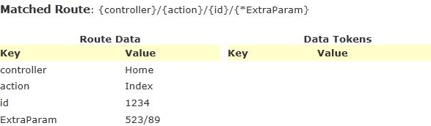
Catch-All Parameter
Catch-All parameter allows for route to match arbitrary number of segments
Catch-All parameter in URL Pattern:
"{controller}/{action}/{id}/{*ExtraParam}"
Example
URL: ~/Home/Index/1234/523/89
RouteDebugger Output:
Notes:
Catch-All parameters allows for route to match arbitrary number of segments. {*ExtraParam} in the above example is a catch-all parameter.
When extra segments are added at the end of URL, their value is stored in the catch-all parameter. For example, /523/89 are extra segments whose value is stored in ExtraParam.
Can think of Catch-all-parameter as an “array of values”

Slide 40
Ambient Route Values
Ambient values are the route values of previous request, which are re-used in the context of the current request
For example, Controller and action values for the second action link is shown as follows:
@Html.ActionLink("Page 2", "List", new { controller = "Tasks", action = "List", page = 2 })
tasks/list/2
@Html.ActionLink("Page 3", "List", new { page = 3 })
tasks/list/3
Notes:
Ambient route values are the route values (maybe taken from URL parameters) from the previous request that are used in the context of the current request.
For example, if we want to list tasks page-wise, we can create an action link as shown above. We have provided both controller, action, and page number for the link.
For showing a link for page 3 on page 2, we can either follow the same approach that we did for Page 2. Or we can shorten it by taking advantage of ambient route values, as follows:
@Html.ActionLink("Page 3", "List", new { page = 3 })
The above call for ActionLink takes the values of controller and action from the previous ActionLink call, and only provides the route value that differs, i.e. Page.
However, it should be noted that explicitly supplied values of controller and action will of course override the ambient values.

Slide 41
Overflow Parameters
Overflow parameters are route values that are not specified in the route’s definition
Appended to generated URL as query string parameters
routes.MapRoute("Reports", "reports/{year}/{month}/{day}", new { day = 1 });
Parameters | Resulting URL | Reason
year=2010, month=1, day=12 | /reports/2010/1/12 | Straightforward match
year=2010, month=1 | /reports/2010/1/1 | Default for day = 1
year=2010, month=1, day=12, category=64 | /reports/2010/1/12?category=64 | Overflow parameters go into query string
Year=2007 | null | Required parameters not provided

Slide 42
URL Generation
RouteCollection.GetVirtualPath (supplied values)
Yes
No
Route has required parameters?
Yes
No Match!
No
Value specified for each required parameter?
Yes
No
Any default values that do not correspond to URL parameters?
Yes
No Match!
No
Does that value match the specified value?
Yes
No
Route has constraints?
Yes
No Match!
No
Are route constraints satisfied?
Yes
Route is a match! Generate the URL.
Notes:
All the methods that are used to generate URLs eventually call GetVirtualPath to do the job. RouteCollection.GetVirtualPath() has two method overloads.
public VirtualPathData GetVirtualPath(RequestContext requestContext, RouteValueDictionary values)
public VirtualPathData GetVirtualPath(RequestContext requestContext, string name, RouteValueDictionary values)
The route collection loops through each route and checks if a URL can be generated given the parameters via Route.GetVirtualPath method. This is similar to the logic applied for an incoming request. If the route matches, the method call replies with VirtualPathData instance containing URL and information about the match. If not, it returns null and the routing system moves on to the next route.
The second method overload provides the route name as well. Route name is unique within the route collection. Since a route name is specified, routing does not need to loop through each route. It immediately finds the route with the specified name, and performs the match. If the route matches, it returns VirtualPathData object. If not, it just returns null.
User calls RouteCollection.GetVirtualPath( ) method. It is passed with request context, dictionary of values and an optional route name.
Routing checks if the selected route has any required parameters. If it does, it proceeds to step 3. Otherwise, it proceeds to step 6. For example: URL pattern: {controller}/{action}, Defaults: action = “Index” … In this case, {controller} is required because it has no defaults specified.
Routing checks if there is a value specified for each required parameter. If not, it results to “No Match “for the route since the required parameter values are not specified.
It checks if there are any default values specified for the route that do not correspond to URL parameters. If there are, it proceeds to next step. If not, it skips the next step. For example: URL pattern: {foo}/{bar}, Defaults: controller = “Home”, foo = “xyz” … In this case controller has a default value that does not correspond to a URL parameter.
It checks if the specified default value (that does not correspond to a URL parameter) in the route matches the user specified value. If it does not match, the route is a no match and the routing system proceeds to the next route. For example: URL pattern: todo/{action}, Defaults: controller = “Home”, action = “Index” … If the user specifies, controller=“blah” and action=“anything”, the route will not match because user cannot specify any different value for a parameter that doesn’t correspond directly to the URL parameter. In this case, user cannot specify any value for controller other than “Home”, or else the route will not match.
It does not checks if the route has constraints defined. If it does, it proceeds to next step. Otherwise, the route is a match and the URL is generated.
It checks if “all” route constraints are satisfied. If they are, the route is a match and the URL is generated. If not, the route is a no match and the routing system proceeds to the next route, if any.
https://docs.microsoft.com/en-us/aspnet/core/fundamentals/routing

Slide 43
IApplicationBuilder.UseStaticFiles( )
Enables static file serving for the current request path from the current directory
Added to the application pipeline before MVC
// This method gets called by the runtime. Use this method to configure the HTTP request pipeline.
public void Configure(IApplicationBuilder app, IWebHostEnvironment env)
{
//Add Static files to the request pipeline
app.UseStaticFiles();
app.UseRouting();
//Add MVC with default route to the request pipeline
app.UseEndpoints(endpoints =>
{
endpoints.MapDefaultControllerRoute();
});
}
Startup.cs
Notes:
https://docs.microsoft.com/en-us/aspnet/core/fundamentals/static-files?view=aspnetcore-3.1

Slide 44
Demo: Ambient Route Values
Notes:
Demo Script:
Open Demos\Module 08 - Routing\AmbientRouting project.
Start the app
Show the routing endpoints defined under Startup.cs
Access the URI https://localhost:44309/job/1/tasks/index/99 to show how routing is working
The Task page show some links to access Jobs. However when we click the first link “All jobs” to display all the jobs it keeps the ambient value Job ID (1) from the first request.
Access the second link and show by setting the jobId and id to empty, we achieved the desired URI i.e. https://localhost:44309/Jobs

Slide 45

Module Summary
In this module, you learned about:
Usability guidelines for URLs
ASP.NET MVC Routing
Conventional Routing
Attribute Routing
MVC areas and their route registration
URL generation through routing rules
Request routing pipeline

Slide 46
Lab: Routing

Slide 47


